Slide 1
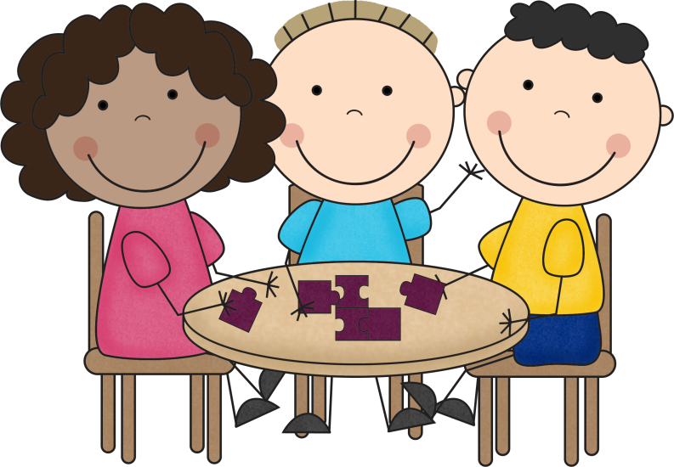
Let’s Collaborate!
For the Santa Ana Students of
1st Grade!
You Rock!

Slide 2
What do you see? What do you hear?

Slide 3
What do you see? What do you hear?

Slide 4
What do you see? What do you hear?

Slide 5
What do you see? What do you hear?

Slide 6
What do you see? What do you hear?

Slide 7
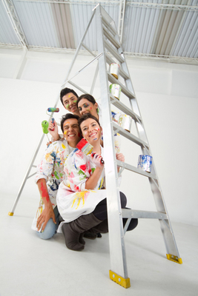
What do you see? What do you hear?

Slide 8
What do you see? What do you hear?

